Slide 1

Evolving Treatment Algorithm in AML
Konstanze Döhner
Department of Internal Medicine III,
Ulm University Hospital, Ulm, Germany

Slide 2
DISCLOSURES OF COMMERCIAL SUPPORT
Name of Company | Research support | Employee | Honoraria | Stockholder | Speaker’s Bureau | Advisory Board
Novartis | √ |  | √ |  |  | √
Janssen |  |  | √ |  |  | √
Celgene | √ |  | √ |  |  | √
Astellas |  |  | √
Daiichi Sankyo |  |  | √ |  |  | √
Roche |  |  |  |  |  | √
CTI BioPharma |  |  |  |  |  | √

Slide 3


Approved drugs in AML since 1990
1990
Idarubicin
2000
Gemtuzumab ozogamicin
Voluntarily withdrawn
2010
2008
Azacitidine
BM-blasts: 20%-30%
2015: label extension for blast counts >30%
2012
Decitabine
2017
- Midostaurin
- Enasidenib
- Gemtuzumab
ozogamicin
- Vyxeos
2018
- Ivosidenib
- Gemtuzumab ozogamicin
Vyxeos
Glasdegib
Gilteritinib
Venetoclax
Acute promyelocytic leukemia excluded
EMA
FDA
EMA/FDA

Slide 4
FLT3 Inhibitors
Relative selectivity and molar potency (IC₅₀) of TKIs against FLT3
Agent | Midostaurin | Sorafenib | Quizartinib | Crenolanib | Gilteritinib
Kinase inhibitory activity
Main targets | FLT3, KIT, PDGFR, VEGFR2, PKC family members | FLT3, KIT, PDGFR, RAS, RAF | FLT3, KIT, PDGFR, RET, CSF1R | FLT3, PDGFR | FLT3, AXL
FLT3-ITD IC₅₀, nM (Plasma) | 1000 | 265 | 18 | 35 | 17
Zarrinkar PP, et al. Blood. 2009;114:2984-2992; Collins R, et al. ASCO 2014. [abstract 7027]; Fathi A, et al. The Oncologist. 2011;16:1162-1174; Mori M, et al. ASCO 2014. [abstract 355]; Staudt D, et al. Int J Mol C. 2018; 19(10).

Slide 5
Phase III Study of Chemotherapy + Midostaurin (PKC412)
or Placebo in Newly Diagnosed Patients ≤ 60 Years of Age
with FLT3 Mutated Acute Myeloid Leukemia (RATIFY)
CALGB, AMLSG, CETLAM, ECOG, EORTC, GIMEMA, NCIC, OSHO, PETHEMA, SAL, SWOG
Induction
(1-2 cycles)
CR
Consolidation**
(up to 4 cycles)
CR
Postconsolidation
(up to 12 cycles)
Patients with newly diagnosed AML
≥ 18 to < 60 years with activating FLT3 mutations
Screening within 48hrs*
Stratification by TKD and ITD
(ratio < 0.7 vs ≥ 0.7)
(n = 717)
Midostaurin
(50 mg bid, days 8-21)
Midostaurin
(50 mg bid, days 8-21)
Midostaurin
(50 mg bid, days 1-28)
Daunorubicin
(60 mg/m²/day, days 1-3)
High-dose
cytarabine
(3 g/m²/day q12h, days 1, 3, and 5)
Primary endpoint: OS
Key secondary endpoint: EFS
Cytarabine
(200 mg/m²/day, days 1-7)
R
Placebo
(bid, days 8-21)
Placebo
(bid, days 8-21)
Placebo
(bid, days 1-28)
Daunorubicin
(60 mg/m²/day, days 1-3)
High-dose
cytarabine
(3 g/m²/day q12h, days 1, 3, and 5)
Double blind
First patient enrolled July 2008,
last patient enrolled October 2011
3270 screened, 717 randomized
Cytarabine
(200 mg/m²/day, days 1-7)
* Patients may receive hydroxyurea during screening phase
** Patients with an HLA-compatible family donor may proceed to allogeneic HSCT
ClinicalTrials.gov NCT00651261
Stone RM et al., N Engl J Med. 2017; 377:354-64

Slide 6
22% reduced risk of death in the midostaurin arm (vs placebo)
 | Patients, n | Median (95% CI), months | HR (95% CI) | P Value
Midostaurin | 360 | 74.7 (31.5-NE) | 0.78 (0.63-0.96) | .009
Placebo | 357 | 25.6 (18.6-42.9)
Midostaurin | 360 | 269 | 209 | 181 | 151 | 97 | 37 | 1
Placebo | 357 | 221 | 163 | 147 | 129 | 80 | 30 | 1

Slide 7
Consistent effect on OS by FLT3 mutation type
 | N | HR (95% CI) | HR (95% CI) | P Value
Overall (stratified) | 717 |  | 0.78 (0.63-0.96) | .009
FLT3-ITD high | 214 |  | 0.80 (0.57-1.12) | .19
FLT3-ITD low | 341 |  | 0.80 (0.60-1.11) | .19
FLT3-TKD | 162 |  | 0.65 (0.39-1.08) | .10
Favors midostaurin
Favors placebo
Stone RM et al., N Engl J Med. 2017; 377:354-64

Slide 8
Overall Survival - Post-Transplant
Treatment with Midostaurin increases OS after HCT in CR1
 |  | Patients, n | Median (95% CI), months | P Value
SCT in CR1 | Midostaurin | 101 | NE (69.8-NE) | .07
 | Placebo | 81 | NE (21.8-NE)
SCT outside CR1 | Midostaurin | 112 | 14.8 (9.1-31.6) | .85
 | Placebo | 115 | 14.4 (10.0-22.7)
100
90
Patients Surviving, %
80
70
60
50
40
30
20
10
0
0
12
24
36
48
60
72
80
Patients at risk
Time, months
SCT
in CR1
Midostaurin
Placebo
101 | 71 | 63 | 21 | 0
81 | 50 | 45 | 12 | 0
112 | 49 | 36 | 5 | 0
115 | 47 | 37 | 13 | 0
Midostaurin
Placebo
SCT
outside CR1
Stone RM et al., N Engl J Med. 2017; 377:354-64

Slide 9
Overall survival according to
NPM1/FLT3-ITD ELN 2017 subgroups and treatment
ELN Subgroup^{2,a} | Arm | Patients, n | HR
NPM1^{mut}/FLT3-ITD^{low} | Midostaurin | 85 | 0.52
NPM1^{mut}/FLT3-ITD^{low} | Placebo
NPM1^{mut}/FLT3-ITD^{high} | Midostaurin | 111 | 0.51
NPM1^{mut}/FLT3-ITD^{high} | Placebo
NPM1^{WT}/FLT3-ITD^{high} | Midostaurin | 123 | 0.55
NPM1^{WT}/FLT3-ITD^{high} | Placebo
Favorable risk
Intermediate risk
Adverse risk
Low, < 0.5; high ≥ 0.5
Döhner K, Thiede C, et al. Blood. 2017;130(Suppl 1) [abstract 467], up-date submitted to EHA meeting 2019

Slide 10
Disease-free survival: Postconsolidation therapy
RATIFY: landmark analysis of DFS and maintenance therapy
 | Patients, n | HR (95% CI) | P Value
Midostaurin | 105 | 0.83 (0.48-1.43) | .0495
Placebo | 69
 | Patients, n | HR (95% CI) | P Value
Midostaurin | 60 | 1.43 (0.63-3.25) | .3847
Placebo | 44
100
100
80
80
60
60
Disease-Free Survival, %
Disease-Free Survival, %
40
40
20
20
0
0
0
1
2
3
4
5
6
7
8
9
10
11
12
0
12
24
36
48
60
66
Patients at Risk
Time Since Start of Maintenance, months
Patients at Risk
Time Since Completion of Maintenance, months
Midostaurin |  | 105 |  | 98 |  | 84 |  | 79 |  | 73 |  | 62 |  | 0
Placebo |  | 69 |  | 58 |  | 52 |  | 51 |  | 50 |  | 45 |  | 0
Midostaurin | 60 |  | 44 |  | 41 |  | 32 |  | 10 |  | 1
Placebo | 44 |  | 39 |  | 34 |  | 23 |  | 12 |  | 0
Larson RA, et al. Blood. 2017;130(suppl 1) [abstract 145]

Slide 11

Midostaurin plus chemotherapy for FLT3-ITD+ AML
AMLSG 16-10 Trial
Patients with
FLT3-ITD+ª AML
Aged 18-70 years
(n = 440)
Induction
(1-2 cycles)^{b}
CR
Consolidation
(1 cycle)^{c}
Consolidation
(first priority)
CR
Maintenance
(up to 1 year)
Midostaurin
(50 mg bid, day 8 until
48h before start of subsequent cycle)
Midostaurin
(50 mg bid, day 6 until
48h before start of subsequent cycle)
Allogeneic HSCT
Midostaurin
(50 mg bid, days 1-28; starting 30 days after alloSCT)
Daunorubicin
(60 mg/m²/day, days 1-3)
HiDAC^{d}
(aged-based dosing, days 1, 3, and 5)
(second priority;
× 3 cycles)
Cytarabine
(200 mg/m²/day, days 1-7)
Midostaurin
(50 mg bid, day 6 until
48h before start of subsequent cycle)
Midostaurin
(50 mg bid, days 1-28)
HiDAC^{d}
(aged-based dosing, days 1, 3, and 5)
ª FLT3 screening results within 48 hours
^{b} During induction, patients achieving PR after cycle 1 can receive an optional cycle 2
^{c} For patients eligible for alloSCT, 1 course of HiDAC is optional before alloSCT
^{d} Age-appropriate cytarabine dose on days 1, 3, and 5: 18-65 years, 3 g/m² q12h (total dose 18 g/m²);
> 65 years ,1 g/m² q12h (total dose 6 g/m²)
Schlenk RF, et al. Blood. 2016;128(22) [abstract 449]. https://clinicaltrials.gov/ct2/show/NCT01477606
Primary endpoint: EFS
Secondary endpoints: CR, RFS, OS, CIR

Slide 12
Event-free and overall survival by age group:
Analysis of the first two cohorts* (AMLSG 16-10)
Event-free survival
Overall survival
1.00
P=0.51
1.00
I
P=0.06
I
I
I
I
I
I
I
I
I
I
0.75
0.75
I
I
I
18-60 years, n=198
2-yr OS: 53.2%
I
I
I
I
I
I
I
I
I
I
I
I
I
I
I
I
I
I
I
18-60 years, n=198
2-yr EFS: 39.3%
I
I
I
I
I
I
I
I
I
I
I
I
I
I
I
I
I
I
I
I
I
I
I
I
I
I
I
I
I
I
I
I
I
I
I
I
I
I
I
I
I
I
I
I
I
I
I
I
I
I
I
I
I
I
I
I
I
I
I
I
I
I
I
I
I
I
I
I
I
I
I
I
I
I
I
I
I
I
I
I
I
I
I
I
EFS probability
I
0.50
OS probability
0.50
I
I
I
I
I
I
I
I
I
I
I
I
I
I
I
I
I
I
I
I
I
I
I
I
I
I
I
I
I
I
I
I
I
I
I
I
I
I
I
I
I
I
I
I
I
I
I
I
I
I
I
I
I
I
I
I
I
I
I
I
I
I
I
I
I
I
I
I
I
I
I
I
I
I
I
I
I
I
I
I
I
I
I
I
I
I
I
I
I
I
I
I
I
I
I
I
I
I
I
I
I
I
I
I
I
I
I
I
I
I
I
I
I
I
I
I
I
I
I
I
I
I
I
I
I
I
I
I
I
I
61-70 years n=86
2-yr OS: 45.6%
I
0.25
61-70 years, n=86
2-yr EFS: 33.6%
I
I
0.25
0.00
0.00
0
6
12
18
24
30
36
42
48
0
6
12
18
24
30
36
42
48
Age
Time since inclusion (months)
Age
Time since inclusion (months)
18-60
198
129
89
63
44
33
23
8
4
18-60
198
163
115
81
58
42
31
13
4
61-70
86
55
35
23
14
12
6
5
2
61-70
86
62
41
31
21
17
10
7
4
*n= 284 patients with AML and FLT3-ITD
Schlenk RF, et al. Blood. 2018 Dec 18. [Epub ahead of print]

Slide 13
Comparison AMLSG 16-10 vs historical controls -
Propensity score weighting analysis* of event-free survival
Age 18-60 years
Age 61-70 years
1.00
I
1.00
I
I
I
0.75
0.75
I
I
I
I
I
I
I
I
I
I
I
I
I
I
I
I
I
I
I
I
I
I
I
EFS probability
0.50
I
EFS probability
I
I
I
0.50
I
I
I
I
I
I
I
I
I
I
I
I
I
I
I
I
I
I
I
I
I
I
I
I
I
I
I
I
I
I
I
I
I
I
I
I
I
I
I
I
I
I
I
I
I
I
I
I
I
I
I
I
I
I
I
I
I
I
I
I
I
I
I
I
I
I
I
I
I
I
I
I
I
I
I
I
I
I
I
I
I
0.25
I
I
I
0.25
I
I
I
I
I
I
I
I
I
I
I
I
I
I
I
I
I
I
I
I
I
I
0.00
I
0.00
0
6
12
18
24
30
36
42
48
54
60
0
6
12
18
24
30
36
42
48
54
60
Time since inclusion (months)
Time since inclusion (months)
Cohort
Cohort
16-10:
198
129
89
63
44
33
23
8
4
0
0
16-10:
86
55
35
23
14
12
6
5
2
0
0
historical:
353
179
111
93
81
77
72
66
56
54
48
historical:
62
20
9
6
5
3
3
3
3
3
3
HR = 0.61 (95%CI 0.49, 0.76; p<0.001)
HR = 0.42 (95%CI 0.29, 0.61; p<0.001)
*Propensity score weighting on age, gender, WBC, marrow blasts, NPM1 mutations
Schlenk RF, et al. Blood. 2018 Dec 18. [Epub ahead of print]

Slide 14
Landmark analysis at day 100 after allogeneic HCT of patients who started Midostaurin maintenance or not
Event-free survival
Overall survival
Multivariable analysis adjusted for FLT3-ITD allelic ratio, NPM1 mutational status, age (18-60 vs >60 yrs), sex, white cell counts, and bone marrow blast % revealed a significant impact of maintenance therapy on EFS (HR, 2.51; P=0.01) and OS (HR, 2.64; P=0.004)
Schlenk RF, et al. Blood. 2018 Dec 18. [Epub ahead of print]
Notes:
This slide shows you data from our landmark analysis at day 100 after alloSCT of patients who startet Midostaurin treatment or not
In total 207 of the 284 pts had alloSCT in our study and one third of them received maintenance therapy with midostaurin
The deium duration of maintenencae was 9 moths
On the lefthand side you see the EFS, on the right hand side OS, pts treated with mido in black, pts without mido in red
And you can see that maintenncae with Mido was associated with an improvied EFS and an improved OS
and in multivariable analysis maintenance therapy with mido had a signficant impact on both clinical endpoints
This is preliminary data in a small cohrot of pts and theses data have to be validated in the final analysisi

Slide 15
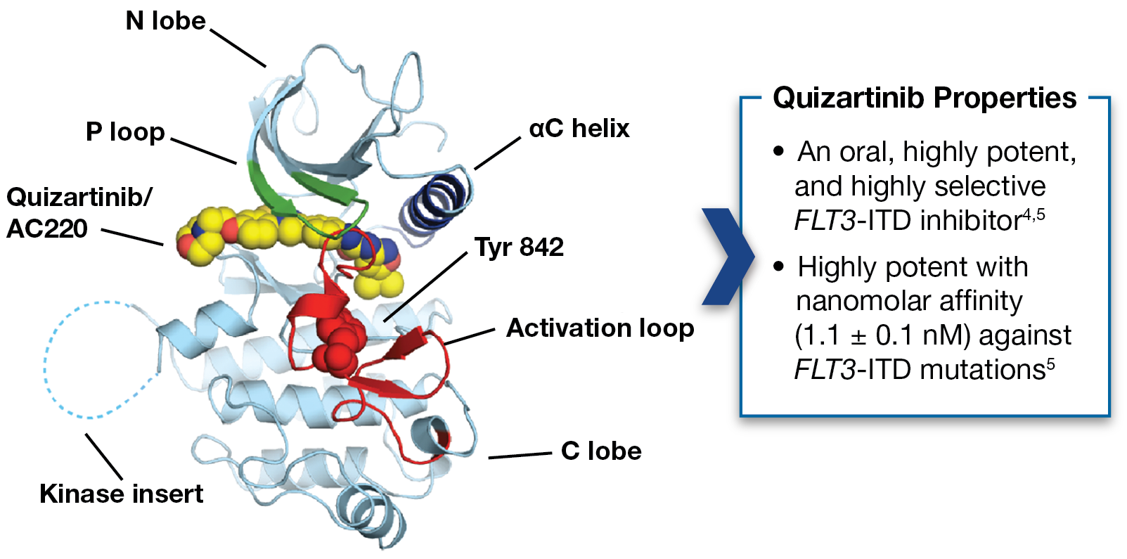
Quizartinib
An oral, highly selective and highly potent
FLT3 inhibitor against FLT3-ITD mutants
Reduces blast burden by induction of differentiation and cytotoxicity
Treatment-related AEs (30-60mg/die): Anemia, febrile neutropenia, pyrexia, GI, QT prolongation (3-5%)
TKD mutations appear to be a resistance mechanism
Cortes J, et al. J Clin Oncol. 2012;31:3681-3687; Zarrinkar P, et al. Blood. 2009;114:2984-2992.

Slide 16
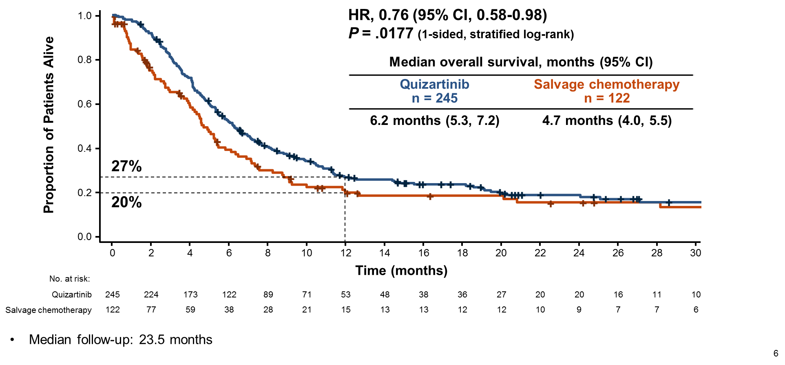
QuANTUM-R study: Quizartinib in r/r FLT3-ITD positive AML
Overall survival
(Primary endpoint)
Eligibility
  Adults ≥18 yrs
  r/r AML (relapse ≤6 mos)
  FLT3-ITD positive
Phase 3 (NCT02039726)
Quizartinib
R
n=367; 2 : 1
Salvage chemotherapy
Secondary/exploratory endpoints
EFS: HR=0.9 (p=.107; IIT analysis)
HR=0.72 (p=.006; per protocol analysis)
CRc: 48% vs 27%
DOR: 12.1 vs 5 mos
HCT: 32% vs 12%
Cortes J, et al. ASH 2018, abstract #563

Slide 17
Quizartinib: QuANTUM-First Study
  Phase 3, randomized, double-blind placebo-controlled study
CR
Consolidation
(up to 4 cycles)
Induction
(1-2 cycles)
CR
Postconsolidation
(up to 12 cycles)
Quizartinib
(40 mg/day following chemotherapy)
Quizartinib
(40 mg/day following cytarabine)
Quizartinib
(30 mg titrated to 60 mg/day)
Patients with newly diagnosed AML aged 18-75 years with FLT3-ITD mutations
(n = 536)
Daunorubicin or idarubicin
Cytarabine
Accrual is ongoing
Expected primary completion date: Nov 2020
Cytarabine
R
Placebo
(following chemotherapy)
Placebo
(following cytarabine)
Placebo
Daunorubicin or idarubicin
Cytarabine
1 cycle = 28 days
Double blind
Primary endpoint: EFS
Secondary endpoints: OS, CR and CRc after 1st induction cycle, CR_{MRD-}
Cytarabine
www.clinicaltrials.gov/ct2/show/NCT02668653. Accessed Oct 23, 2017

Slide 18
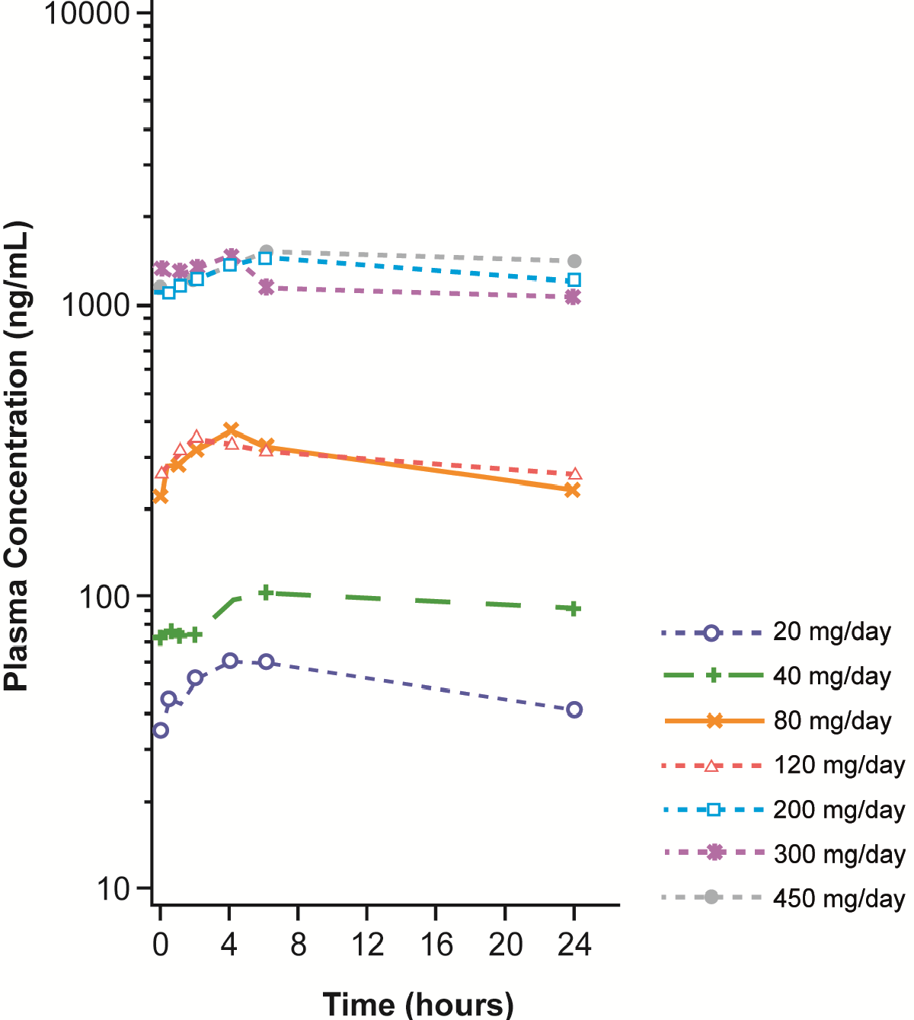
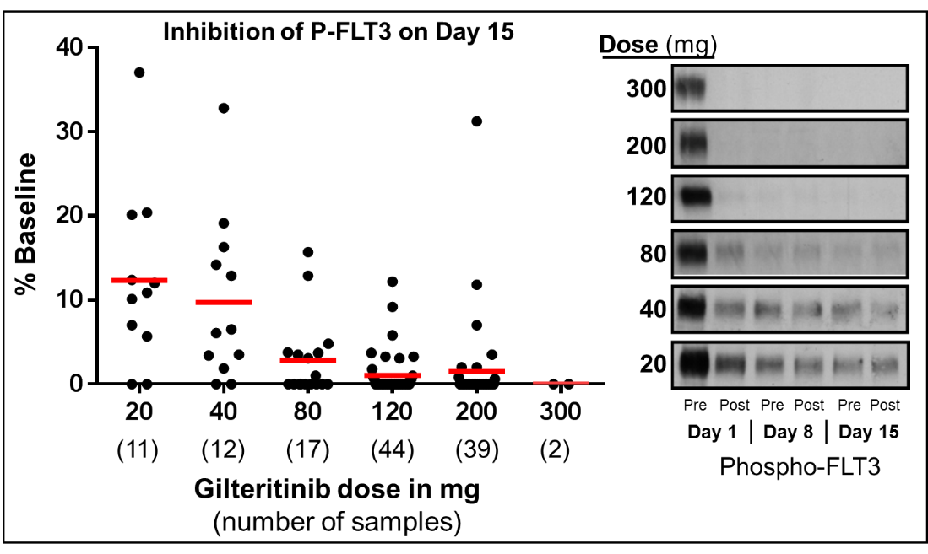
Gilteritinib pharmacokinetic profile and
pharmacodynamic effects
Multiple-dose concentration time curve
Plasma inhibitory activity (PIA) of Gilteritinib against FLT3
Perl AE, et al. Lancet Oncol. 2017;18(8):1061-1075.

Slide 19
CHRYSALIS: Antileukemic activity in r/r FLT3-mutated AML by Gilteritinib dose (n = 191)
ORR = 55%
CRc (CR/CRi/CRp): 46%
120 mg > recommended dose for phase 3
Patients Achieving Response, %
Gilteritinib dose (no. of samples)
Perl AE, et al. Lancet Oncol. 2017;18:1061-1075.

Slide 20
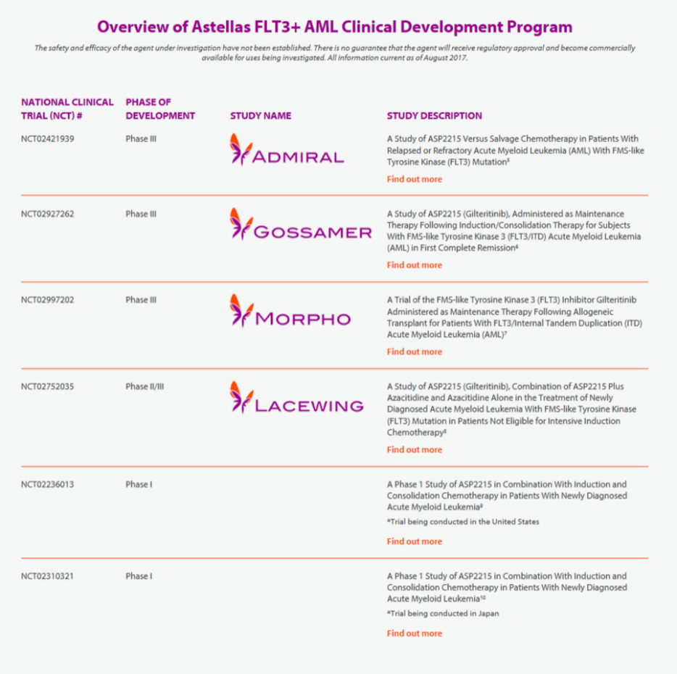

ADMIRAL study: Gilteritinib in r/r FLT3-mutated AML
Phase 3 (NCT02421939)
Eligibility
  Adults ≥18 yrs
  r/r AML
  FLT3 mutation
Primary endpoint:
Overall survival
Gilteritinib
R
n=369; 2 : 1
Salvage chemotherapy*
Interim analysis
Median f/u: 4.6 mos
CR/CRh: 21%
Transfusion-free: 31%
* MEC, mitoxantrone, etoposide, cytarabine; FLAG-Ida, fludarabine, cytarabine, G-CSF, idarubicin; Azacitidine; low-dose cytarabine
r/r AML with a FLT3 mutation
November 28, 2018
https://www.fda.gov/Drugs/InformationOnDrugs/ApprovedDrugs/ucm627045.htm (assessed on January 20, 2019)

Slide 21
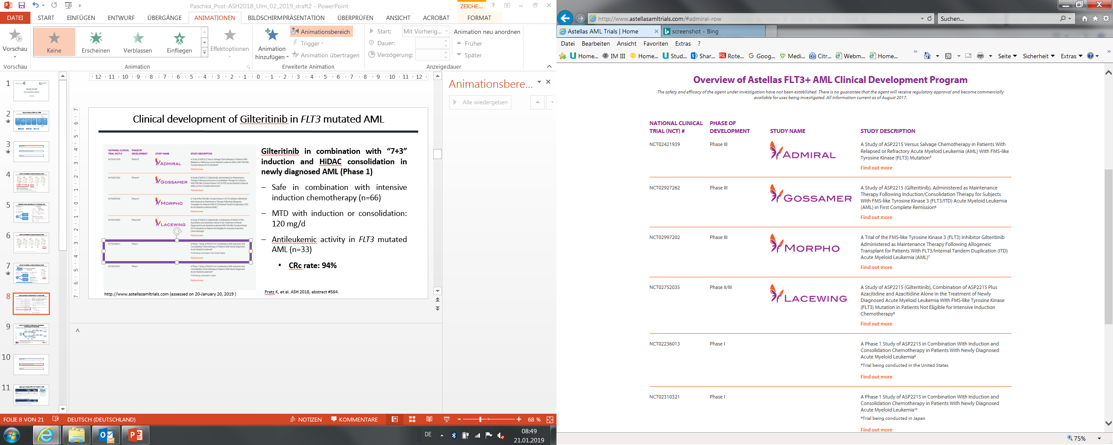
Gilteritinib clinical development program
Gilteritinib in combination with “7+3” induction and HiDAC consolidation in newly diagnosed AML (Phase 1)
Safe in combination with intensive induction chemotherapy (n=66)
MTD with induction or consolidation: 120 mg/d
Antileukemic activity in FLT3-mutated AML (n=33)
  CRc rate: 94%
Pratz K, et al. ASH 2018, abstract #564.
http://www.astellasamltrials.com (assessed on January 20, 2019)

Slide 22








Midostaurin vs Gilteritinib plus intensive chemotherapy for AML with FLT3 mutation – AMLSG 28-18 Study
Induction I
Induction II
Consolidation
1-yr Maintenance
Expected start: Q1 / 2019
IDAC
Midostaurin
IDAC
Midostaurin
IDAC
Midostaurin
Dauno
Cytarabine
Midostaurin
Dauno
IDACª
Midostaurin
Midostaurin
Option 2^{b}
Midostaurin
≥18 yrs
AML with FLT3 mutation
R
n=768
IDAC
Gilteritinib
IDAC
Gilteritinib
IDAC
Gilteritinib
Dauno
Cytarabine
Gilteritinib
Dauno
IDACª
Gilteritinib
Gilteritinib
Option 2^{b}
Gilteritinib
Primary endpoint: EFS
Key secondary endpoints: OS, CR rate
Assignment to allogeneic HCT^{c}
Patients in CR/CRi after two cycles of induction proceed to AMLSG/HOVON-specific consolidation therapy; assignment to allogeneic hematopoietic cell transplantation (HCT) according to the local institutional or cooperative group prognostic algorithm; HCT can be performed at any time point following one induction cycle, ªIDAC, intermediate-dose cytarabine; age-adapted dosing, ^{b}HOVON consolidation: autologous HCT; or mitoxantrone / etoposide, ^{c}Assignment based on patient- and disease-related factors

Slide 23
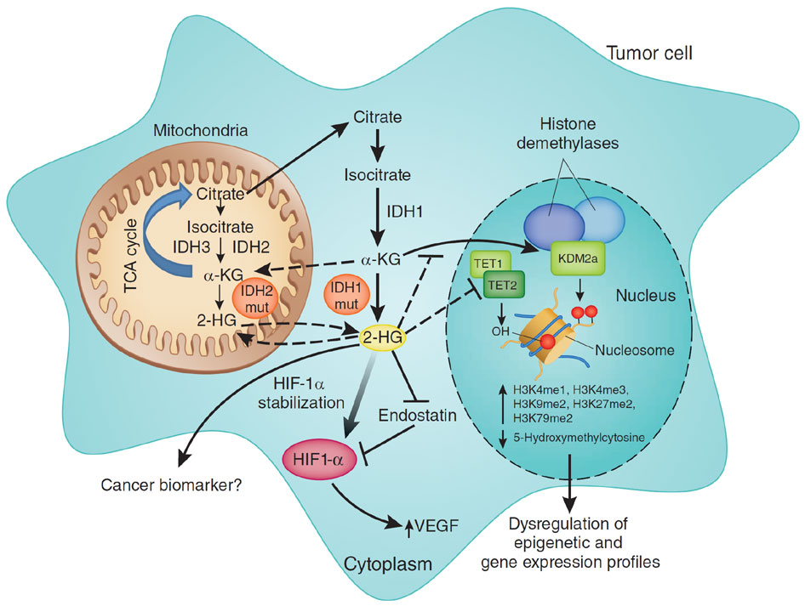

Mutated IDH1 / IDH2 enzymes as targets in AML
Mutant IDH1 and IDH2 activity and
2-HG signalling in cancer¹
Mutation frequency in AML (n=2,464 pts)²
Mutation frequency: IDH1: 7.5%; IDH2: 11.5%
Neomorphic activity of mutant IDH1/2 enzymes → oncometabolite 2-HG
Specific inhibitors of mutant IDH enzymes (enasidenib, ivosidenib) in clinical development
Dang L, et al. Nature. 2009;462(7274):739-44.
Ward PS, et al. Cell. 2010;17(3):225-34.
Gross S, et al. J Exp Med. 2010;207(2):339-44.
Xu W, et al. Cancer Cell. 2011;19(1):17-30.
Chaturvedi A, et al. Blood. 2013;122(16):2877-87.
Wang F, et al. Science. 2013;340(6132):622-6.
Stein E, et al. Blood. 2017;130(6):722-31; Blood. 2018 Dec 3. DiNardo CD, et al. N Engl J Med. 2018;378(25):2386-2398.
¹Prensner JR & Chinnaiyan AM. Nat Med. 2011;17(3):291-3; ²Paschka P, Döhner K. Unpublished data.

Slide 24
Enasidenib (AG-221) and Ivosidenib (AG-120) in
mutant IDH2 and IDH1 r/r AML
Enasidenib in r/r IDH2^{mut} AML
Overall response rate (CR, CRi, PR, MLFS): 40.3%
Ivosidenib in r/r IDH1^{mut} AML
Overall response rate (CR, CRi, PR, MLFS): 41.6%
Median OS: 9.3 months (95%CI 8.2, 10.9)
Median OS: 8.2 months (95%CI 5.5, 12.0)
Stein E, et al. Blood. 2017;130(6):722-31.
DiNardo CD, et al. N Engl J Med. 2018;378(25):2386-2398.

Slide 25
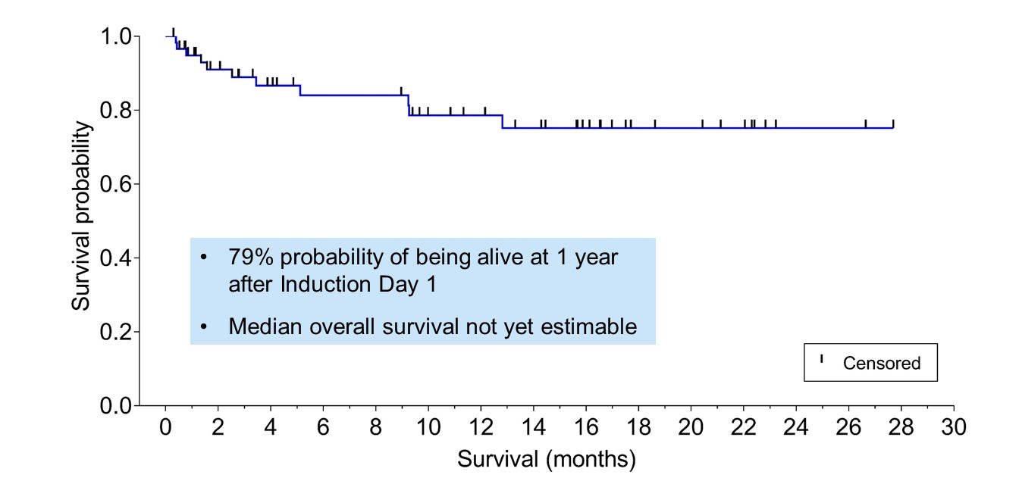
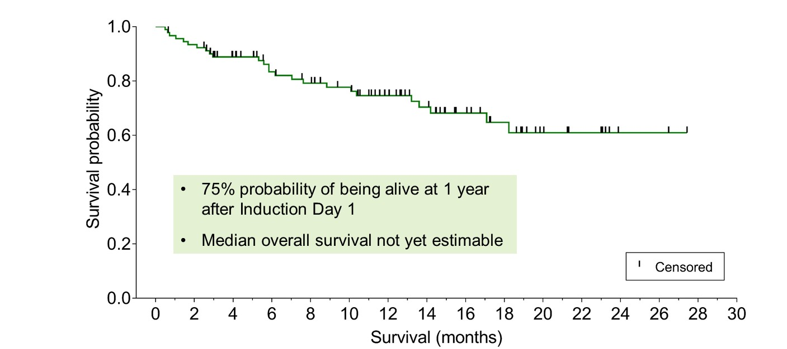
AG-221-120-C-001 study
Ivosidenib (n=60)
Enasidenib (n=93)
Median age: 62.5 yrs
CRc: 80% (CR: 71%)
Median age: 63 yrs
CRc: 72% (CR: 56%)
MRD- in patients with CRc
MFC: 88%
dPCR (IDH1^{mut}): 41%
MRD- in patients with CRc
MFC: 56%
dPCR (IDH2^{mut}): 25%
Stein EM, et al. ASH 2018, abstract #560.

Slide 26

Chemotherapy plus AG-120/AG-221 vs placebo for AML with IDH1/IDH2 mutation – HOVON 150 / AMLSG 29-18
Induction I
Induction II
Consolidation
2-yr Maintenance
IDAC
Placebo
IDAC
Placebo
IDAC
Placebo
Dauno
Cytarabine
Placebo
Dauno
IDACª
Placebo
Placebo
≥18yrs
AML with IDH1/2
mutation
Option 2^{b}
Placebo
R
IDAC
AG120/221
IDAC
AG120/221
IDAC
AG120/221
Dauno
Cytarabine
AG120/221
Dauno
IDACª
AG120/221
AG120/221
Option 2^{b}
AG120/221
Allogeneic HCT^{c}
Primary endpoint: EFS
Patients in CR/CRi after two cycles of induction proceed to AMLSG/HOVON-specific consolidation therapy; assignment to allogeneic hematopoietic cell transplantation (HCT) according to the local institutional or cooperative group prognostic algorithm; HCT can be performed at any time point following one induction cycle
ª IDAC, intermediate-dose cytarabine; age-adapted dosing; no anthracycline ≥60 yrs
^{b} HOVON consolidation: autologous HCT; or mitoxantrone / etoposide
^{c} Maintenance with TKI also after allogeneic HCT
Expected start: Q1 / 2019

Slide 27
CPX-351 (VYXEOS™)
CPX-351 (VYXEOS™)
CPX-351 is a liposomal formulation of cytarabine and daunorubicin encapsulated at a 5:1 molar ratio within 100-nm diameter liposomes
  Median half-life 31.1 hrs (cytarabine) and
  21.9 hrs (daunorubicin)²
  Drug exposure maintained for 7 days²
  Evidence for selective uptake by leukemic vs normal
  cells in bone marrow of leukemia-bearing mice³
  1 unit: 1 mg cytarabine, 0.44 mg dauno
Adapted from Lancet et al., EHA 2017 (P556).
¹Mayer LD et al. Mol Cancer Ther. 2006;5(7):1854-63; ²Feldman EJ et al. J Clin Oncol. 2011;29(8):979–85; ³Lim WS et al. Leuk Res. 2010;34(9):1245–23.

Slide 28
Randomized phase III trial of CPX-351 vs ‘7+3’ in older patients
with high-risk AML
CPX-351 (n=153)
  Stratifications:
    Therapy-related AML
    AML with history of MDS with and without prior HMA therapy
    AML with history of CMML
    De novo AML with MDS karyotype
Key Eligibility
Previously untreated
Ages 60–75
Able to tolerate intensive therapy
ECOG PS 0–2
Follow-up:
Death
OR
5 years
Induction
(1–2 cycles)
Patients in CR or CRi:
Consolidation
(1–2 cycles)
    60–69 years
    70–75 years
7+3 (n=156)
Lancet JE, et al. J Clin Oncol. 2018;36(26):2684-2692.

Slide 29
Randomized trial of CPX-351 vs ‘7+3’in older patients
with high-risk AML
 | CPX-351 n=153 | „7+3” n=156 | Odds Ratio | P
CR+CRi | 47.7% | 33.3% | 1.77 | 0.016
HCT rate | 34.0% | 25.0% | 1.54 | 0.098
Deaths within 60 days | 13.8% | 21.8%
HCT, hematopoietic-cell transplantation
Lancet JE, et al. J Clin Oncol. 2018;36(26):2684-2692.

Slide 30

CPX-351 vs ‘3+7‘ chemotherapy for patients with
intermediate-/adverse-risk AML – AMLSG 30-18
Induction I
Induction II
Consolidation
Dauno
Cytarabine
Dauno
IDACª
IDAC
IDAC
IDAC
Pts ≥18 yrs
Untreated AML, inter-/ adverse-risk (ELN 2017)
R
CPX-351^{b}
d1,3,5
CPX-351^{b}
d1,3
CPX-351^{c}
d1,3
CPX-351^{c}
d1,3
CPX-351^{c}
d1,3
Sensitive response assessment^{d}
Primary endpoint: EFS
Patients ≥18 years eligible for intensive therapy.
Assignment to allogeneic hematopoietic-cell transplantation (HCT) according to the local institutional or cooperative group prognostic algorithm; HCT can be performed at any time point following one induction cycle
ª IDAC, intermediate-dose cytarabine; age-adapted dosing; no anthracycline ≥60 yrs
^{b} Patients 18-60 yrs: CPX-351 55/125 mg/m² (120 U/m²); >60 yrs: CPX-351 44/100 mg/m² (=00 U/m²)
^{c} Patients 18-60 yrs: CPX-351 35/80 mg/m² (80 U/m²); >60 yrs: CPX-351 29/65 mg/m² (65 U/m²)
^{d} Assessment by multi-parameter flow cytometry; and next-generation sequencing based analysis
Expected start: Q1 / 2019

Slide 31
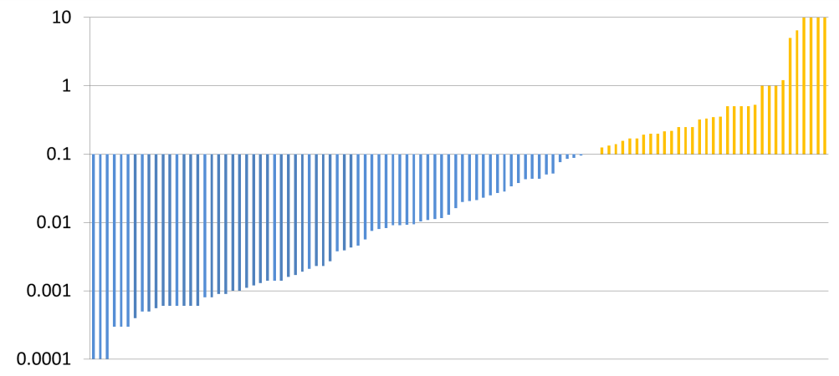

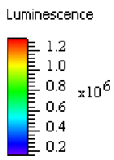
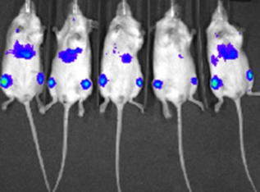
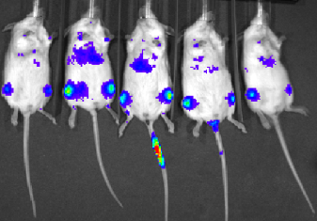
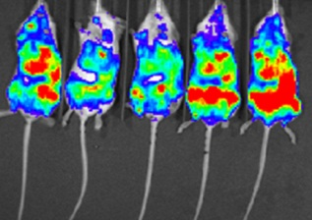
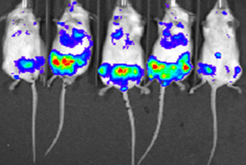
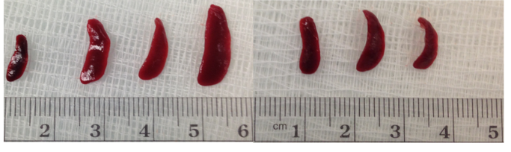
Venetoclax is highly active in preclinical models of AML
AML primary patient samples cultured with venetoclax ex vivo
Systemic model of AML (MOLM13-luciferase)
Vehicle Venetoclax
Day 4
Day 4
Day 14
Day 14
73/106 (69%) primary AML patient samples sensitive to venetoclax-mediated cell killing (IC₅₀ < 100 nM)
Venetoclax inhibits the progression of AML and reduces spleen size in mouse models of systemic AML
IC₅₀, half-maximal inhibitory concentration
Spleens (D15)
Pan R, et al. Cancer Discov. 2014;4:362-375.

Slide 32
Combination therapies with Venetoclax in patients with AML
Non-Intensive Therapy
Venetoclax with LDAC in treatment-naïve elderly patients with AML: a phase I/II study
Strickland S, et al. ASH 2018, abstract #284 [M14-387; NCT02287233]
Safety and preliminary efficacy of venetoclax with decitabine or azacitidine in elderly patients with previously untreated AML: a non-randomized, open-label, phase 1b study
DiNardo C, et al. Lancet Oncol. 2018;19(2):216-228. [M14-358; NCT02203773]
Venetoclax combined with decitabine or azacitidine in treatment-naïve, elderly patients with AML
DiNardo C, et al. Blood 2019;133(1):7-17. [M14-358; NCT02203773]
Azacitidine with Venetoclax or Placebo in pts with newly diagnosed AML ineligible for intensive therapy
Protocol M15-656, Phase III pivotal study; accrual completed [M15-656; NCT02993523]
Interim analysis of Phase II study of Venetoclax with 10-day Decitabine (DEC10-VEN) in AML and MDS
Maiti A, et al (MDACC). ASH 2018, abstract #286 [NCT03404193]
Intensive Therapy
CAVEAT - Chemotherapy And Venetoclax in Elderly AML Trial
Wei AH, et al. ASH 2018; abstract #333 [ACTRN12616000445471]
Venetoclax in combination with FLAG-IDA induction/consolidation therapy in newly diagnosed or R/R AML
DiNardo et al. ASH 2018, abstract #4048 [Phase Ib/II; NCT03214562]
Venetoclax with intensive induction and consolidation chemotherapy in treatment naïve AML
PI: Dr. R. Stone [NCT03709758]; accrual has started

Slide 33
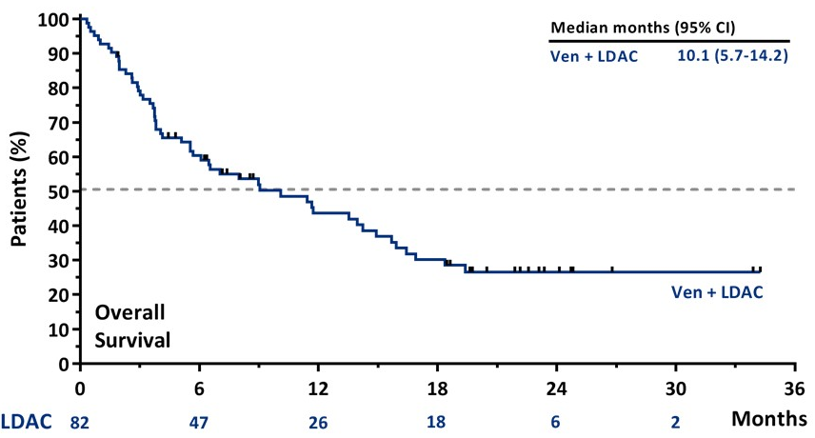
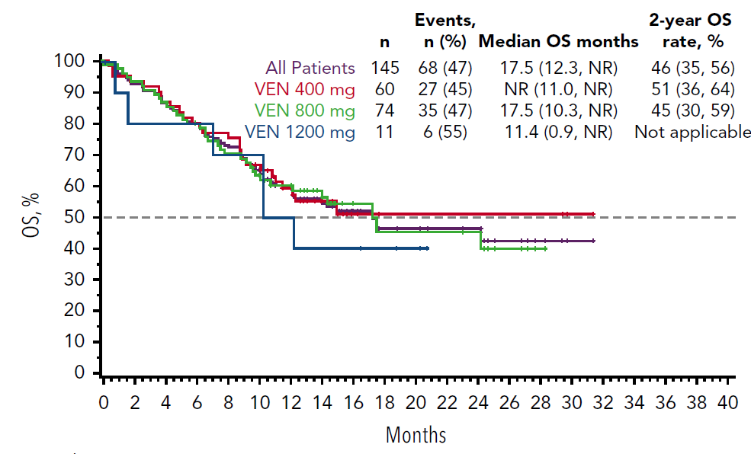
Venetoclax in combination with LDAC or HMAs in newly diagnosed AML patients unfit for intensive chemotherapy
Venetoclax + LDAC
Venetoclax + HMA
Median age: 75 yrs
CR/CRi: 54%
30d-mortality: 6%
Median age: 74 yrs
CR/CRi: 67% (73% with Venetoclax 400 mg)
30d-mortality: 3%
Newly diagnosed AML considered unfit for
intensive chemotherapy
November 21, 2018
Phase I/II (n=82)
NCT02287233
Phase Ib with expansion phase (n=145)
NCT02203773
Pollyea D, et al., ASH 2018, abstract #285.
Di Nardo C, et al. Blood. 2019;133(1):7-17.
Strickland S, et al., ASH 2018, abstract #284.

Slide 34
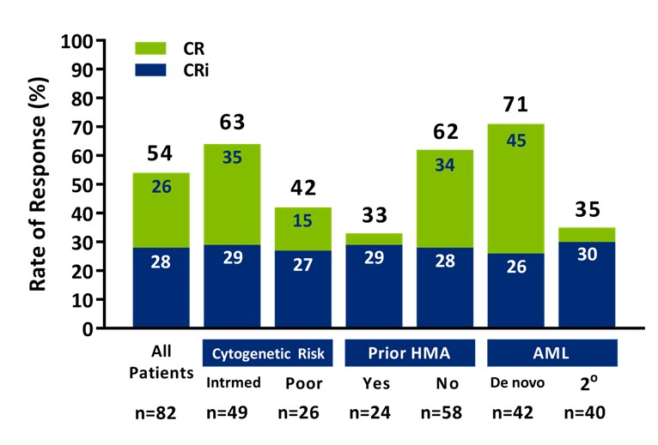
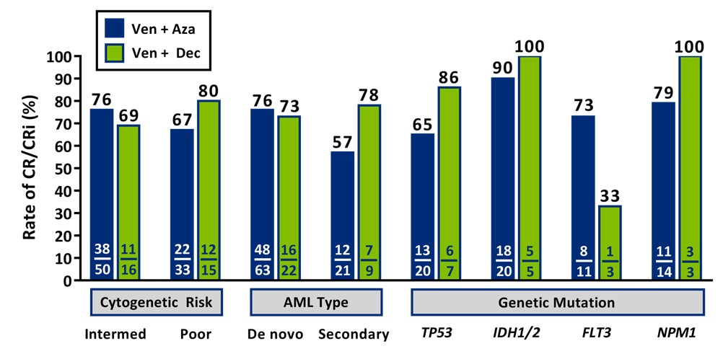
Venetoclax in combination with LDAC or HMAs
- Response rates by subgroups -
Venetoclax + LDAC
Venetoclax + HMA
Strickland S, et al., ASH 2018, abstract #284.
Pollyea D, et al., ASH 2018, abstract #285.
DiNardo C, et al. Blood. 2019;133(1):7-17.

Slide 35


AMLSG: Algorithm of genetic testing and trial portfolio*
AMLSG Center
Reference Lab
AMLSG Center
AMLSG BiO Registry
Genetic Testing
Recommendation
Informed Consent
Diagnostic work-up
Documentation of clinical data
Biobanking
Biosamples (BM/PB) sent via Courier Express
Molecular genetics
PML-RARA
RUNX1-RUNX1T1
CBFB-MYH11
MLLT3-KMT2A
BCR-ABL1
NPM1
CEBPA
FLT3
IDH1/2
RUNX1
ASXL1
TP53
Cytogenetics
APOLLO +/- ATO-ATRA-Ida
AMLSG 21-13 ‚3+7‘ +/- Dasatinib
AMLSG 28-18 ‚3+7‘ + Mido vs Gilteritinib
within 24-48 hrs
AMLSG 29-18 ‚3+7‘ +/- AG-120/-221
AMLSG 30-18 CPX-351 vs ‚3+7‘
AMLSG 31-19 ‚3+7‘ +/- Venetoclax
within 1st Rx cycle
Novartis** ‚3+7‘ +/- Midostaurin
Standard of care
within 5-7 days
0
24
48-72 hrs
7 days a week
* Intensive first-line trials only
** Active in selected AMLSG centers
AMLSG-BiO [NCT01252485]

Slide 36



S. Cocciardi
A. Corbacioglu
J. Herzig
S. Kapp-Schwoerer
J. Krönke
N. Jahn
E. Panina
L. Schmalbrock
D. Späth
F. Theis
F. Stegelmann
V. Teleanu
V. Gaidzik
P. Paschka
F. Rücker
H. Döhner
Ulm University
L. Bullinger
A. Dolnik
T. Blätte
Charité, Universitätsmedizin Berlin
M. Heuser
G. Göhring
F. Thol
B. Schlegelberger
A. Ganser
MHH, Hannover
SFB 1074 Experimental Models and Clinical Translation in Leukemia

